Slide 1
Abstraction Without Guilt
Steve Blackburn
Australian National University

Slide 2
Abstraction

Slide 3
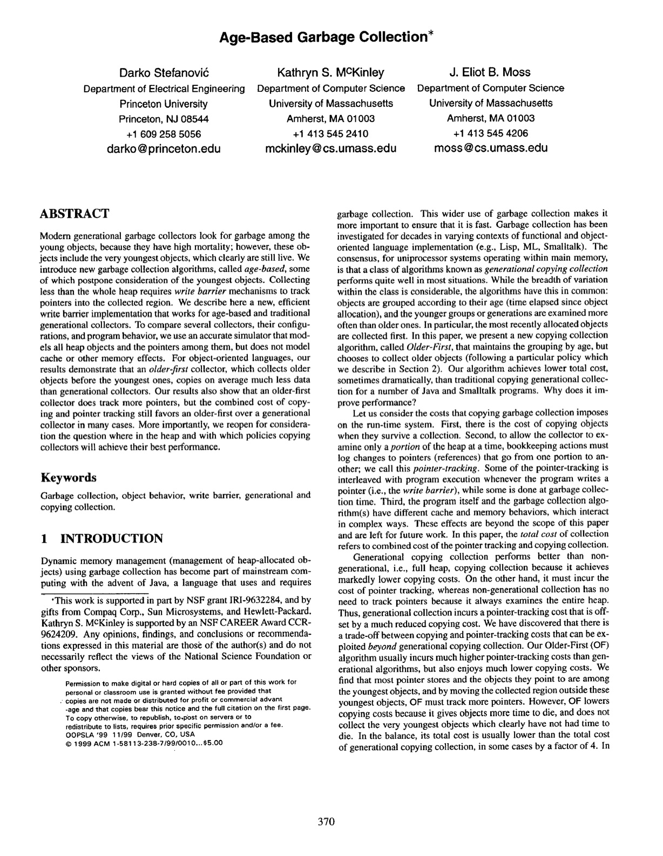
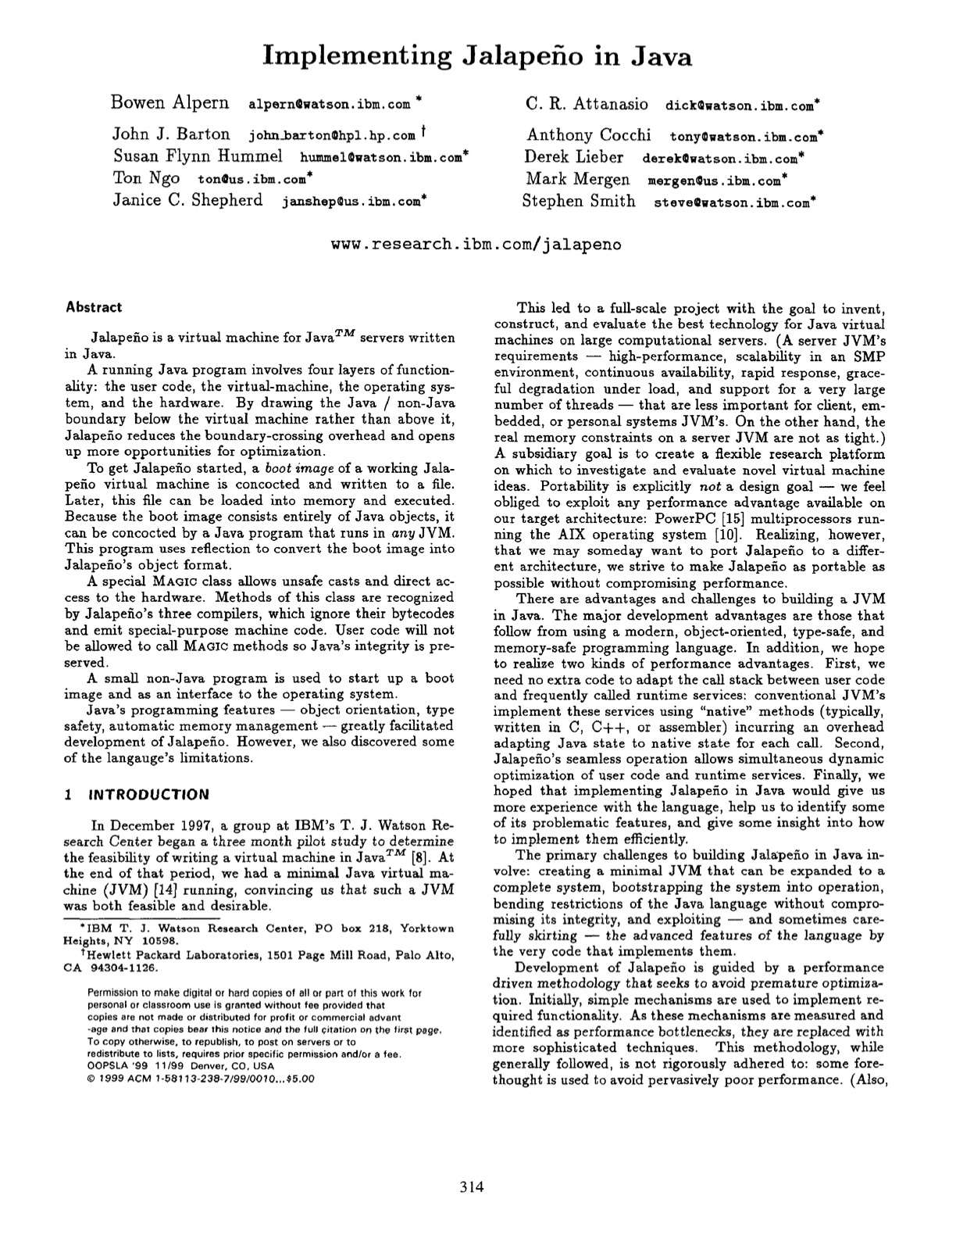
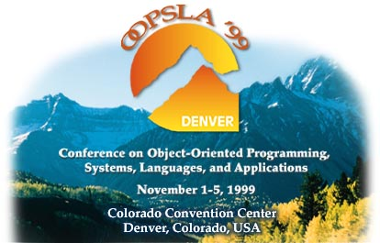
September 1999 Tibet
A Few Days Later Amherst, MA
A Month Later Amherst, MA
A Few Days Later Amherst, MA
Meanwhile… Denver, CO

Slide 4
Part I MMTk (Flexibility & performance: oil & water?)

Slide 5
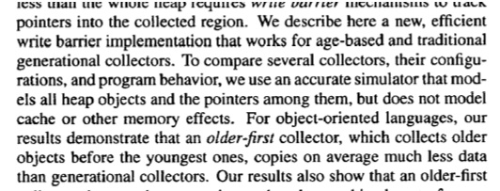

Slide 6
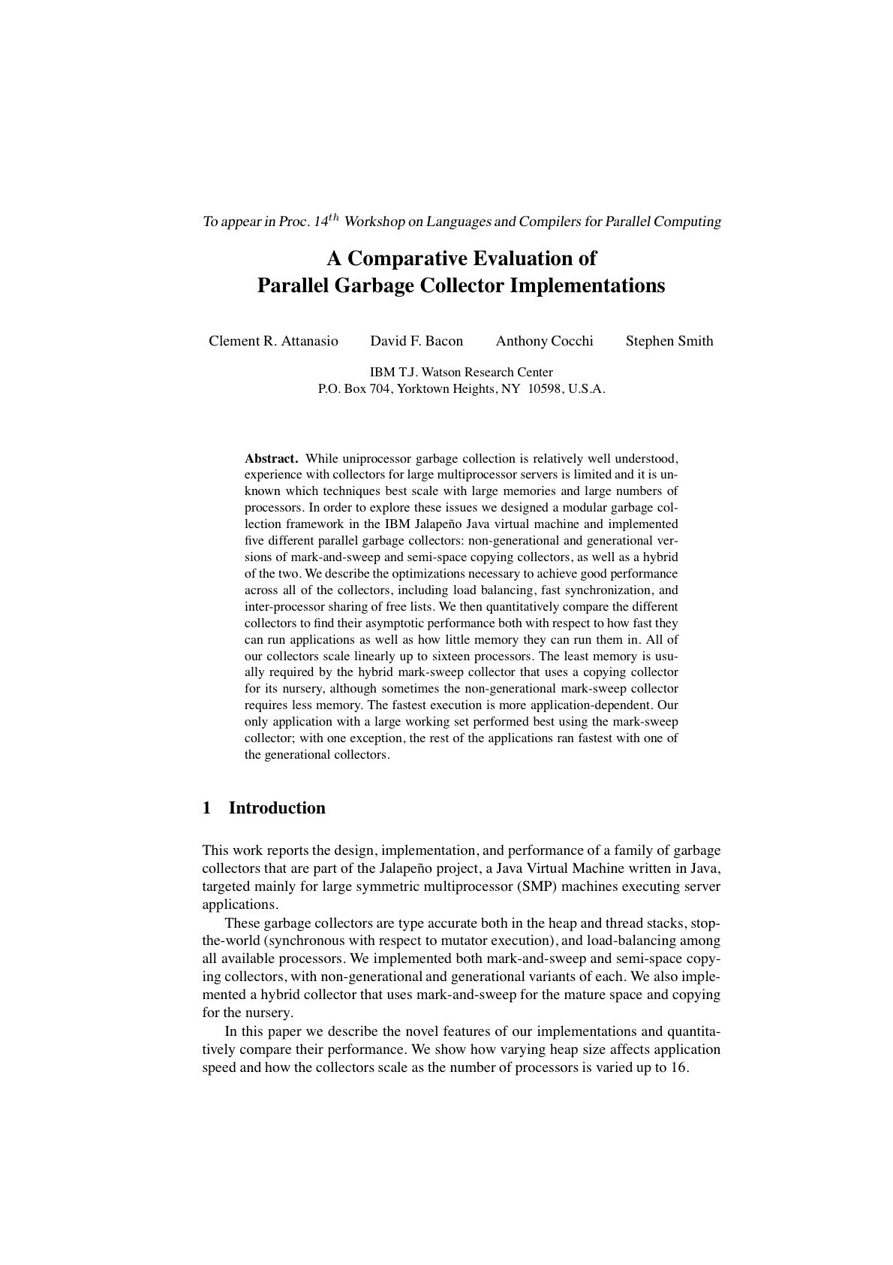
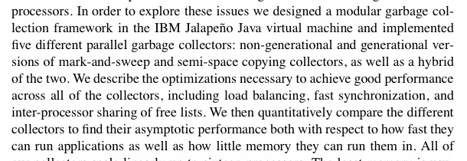

Slide 7
The Researcher’s Dream
Rapid realization of ideas
Express ideas as abstractly as possible
Reuse thoroughly tested building blocks
Apples to apples comparisons
Compare ideas in common framework
Credible artifacts
Performance comparable to production

Slide 8
State of The Art 1999
Stefanović et al
Attanasio et al
Detailed study of mechanisms
Detailed cost model
Done in simulation
Credible artifact
Apples to apples
Rapid realization
Detailed perf. study
Studied in real JVM
Credible performance
Monolithic collectors
Rapid realization
Apples to apples
Credible artifact

Slide 9
(Fast, correct) GC is Hard
Watson 2.0 GenCopy
1035 static void
1036 collect () {
1037 int i,temp,bytes;
1038 boolean selectedGCThread = false; // indicates 1 thread to generate output
1121 // set Done flag to allow other GC threads to begin processing
1122 initGCDone = true;
1123
1124 } // END SINGLE GC THREAD SECTION - GC INITIALIZATION
1125
1126 else {
1127 // Each GC thread must wait here until initialization is complete
1665 gc_checkWriteBuffers();
1666
1667 // all GC threads return, having completed Major collection
1668 return;
1669 } // collect

Slide 10
Our Approach
Premature optimization is evil
Very hard to intuit performance
Have faith!
Vivek’s compiler team is brilliant
Identify and optimize hot paths
Most code is cold, non-critical
Be fearless!
Just assume that things will work OK :-)

Slide 11
Three months later…

Slide 12
Code Complexity
 | methods | NCSS | NCSS/m | ΣCCN
Watson (Jikes RVM 2.2 circa 2003)
GenCopy | 42 | 659 | 15.7 | 220
GenMS | 40 | 531 | 13.3 | 171
MMTk (Jikes RVM 2.2 circa 2003)
GenCopy | 19 | 117 | 6.2 | 49
GenMS | 18 | 104 | 5.8 | 158
Generational | 36 | 279 | 7.4 | 102

Slide 13
Performance
 | Allocation Rate (MB/sec) | Tracing Rate (MB/sec)
Watson SemiSpace | 690 | 58
MMTk SemiSpace | 610 | 55
Watson MarkSweep | 600 | 93
MMTk MarkSweep | 575 | 69

Slide 14
Performance
 | No Inlining (MB/sec) | Inlining (MB/sec)
MMTk SemiSpace | 396 | 610
MMTk MarkSweep | 315 | 575
C malloc() | 478 | n/a
C calloc() | 338 | n/a

Slide 15
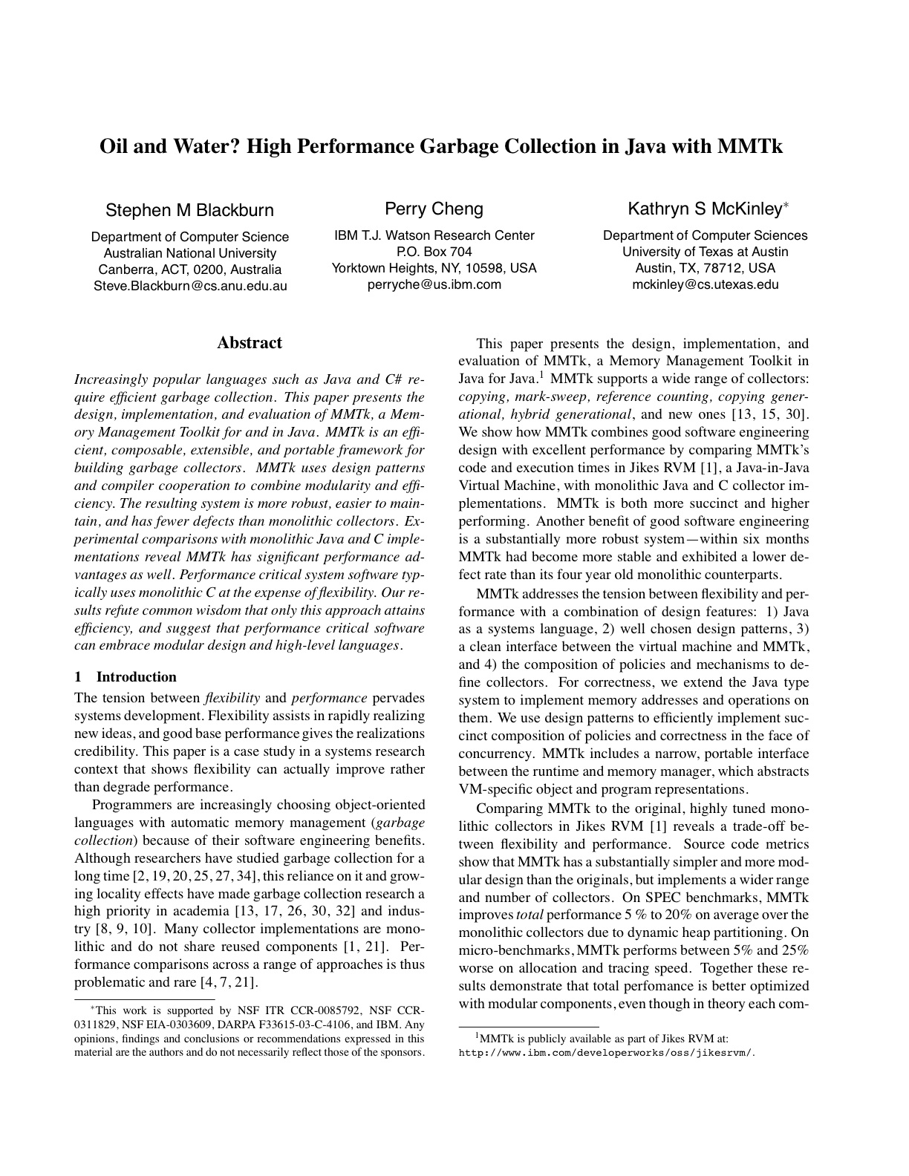
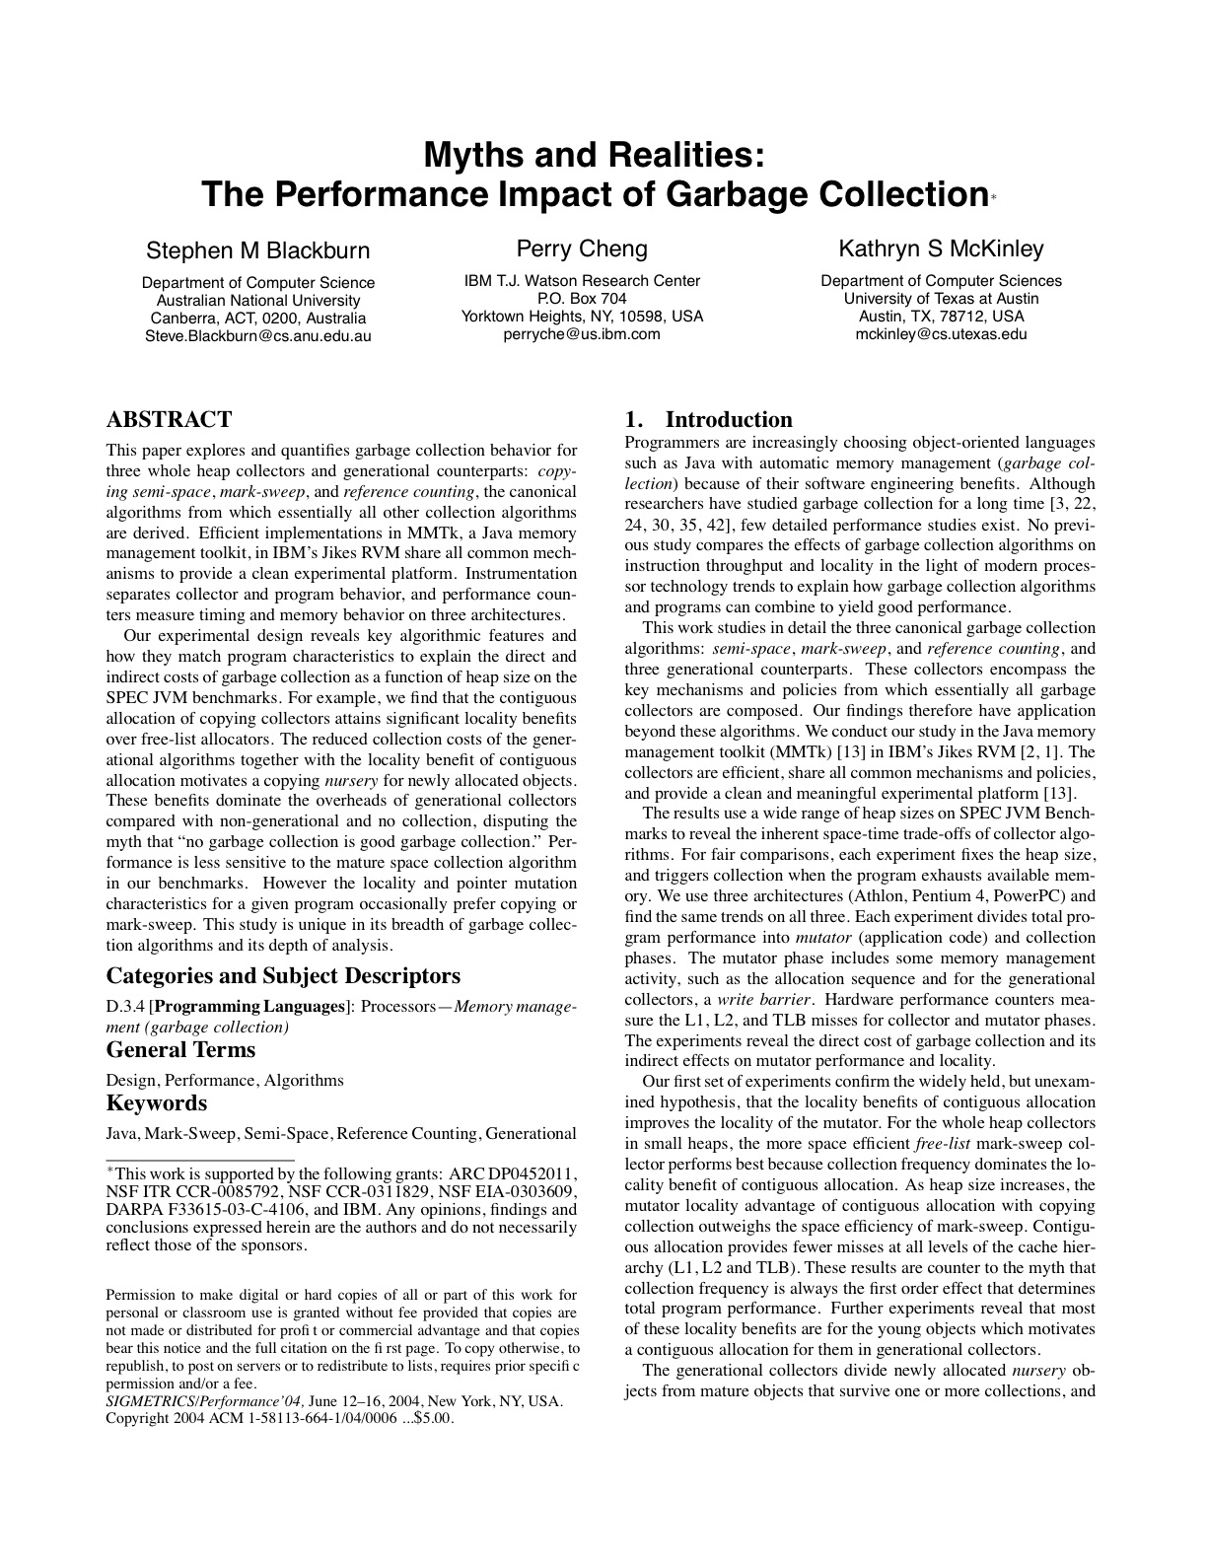
Since Then…
Heavily used
Basis for many new GC algorithms
Basis for comparative studies
Constantly evolving
Constantly pushing limits
Now 12 or so supported GCs
High performance

Slide 16
The Lessons…
Appropriate abstraction is a game changer.
Flexibility & performance ≠ Oil & water.
(Building good infrastructure is hard.)

Slide 17
Part II vmmagic (Having your cake and eating it.)

Slide 18
Why Java? (Why not C?)
Type safety
Memory safety
Encapsulation, composition, reuse
Concurrency (language supported)
etc…

Slide 19
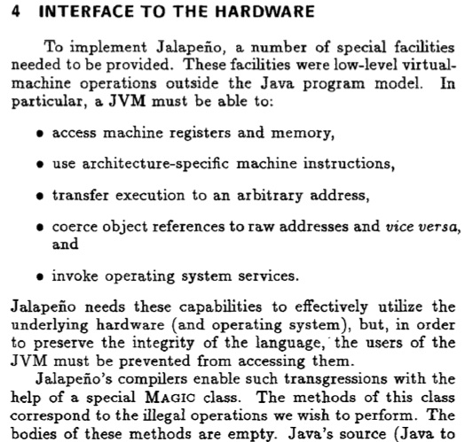
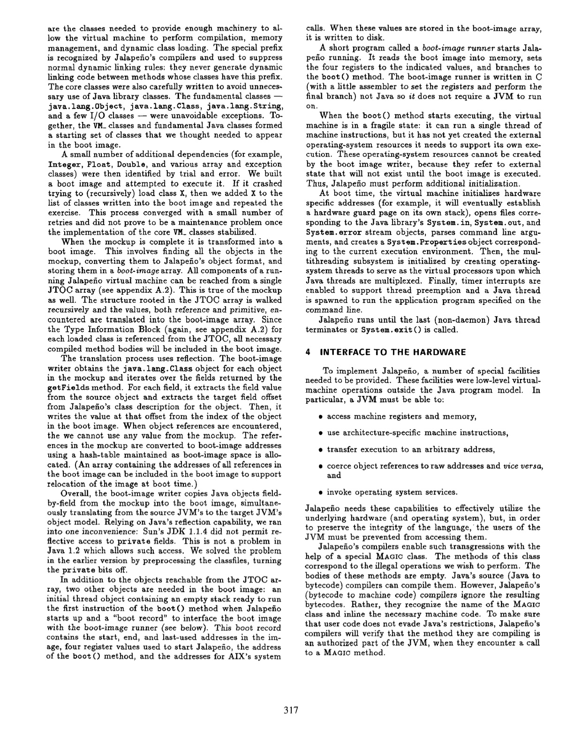

Slide 20
(Fast, correct) GC is Hard
Watson 2.0 GenCopy
1035 static void
1036 collect () {
1037 int i,temp,bytes;
1038 boolean selectedGCThread = false; // indicates 1 thread to generate output
1121 // set Done flag to allow other GC threads to begin processing
1122 initGCDone = true;
1123
1124 } // END SINGLE GC THREAD SECTION - GC INITIALIZATION
1125
1126 else {
1127 // Each GC thread must wait here until initialization is complete
1665 gc_checkWriteBuffers();
1666
1667 // all GC threads return, having completed Major collection
1668 return;
1669 } // collect

Slide 21
A Dirty Little Secret
+kADDRESS=int
and you can’t use new()
avoid method calls
avoid inheritance

Slide 22
Why Java? (Why not C?)

Type safety
Memory safety
Encapsulation, composition, reuse
Concurrency (language supported)
etc…





Slide 23
The Problem
Systems programmers:
Strive for reliability, security, maintainability
Depend on performance and transparent access to low-level primitives
Abstraction:
Enables the former
Typically obstructs the latter

Slide 24
Why (1975)
James J. Horning, Yes! High level languages should be used to write systems software. ACM Annual Conference/Annual Meeting
Proceedings of the 1975 Annual Conference.
Notes:
…but is the problem still relevant today? …

Slide 25
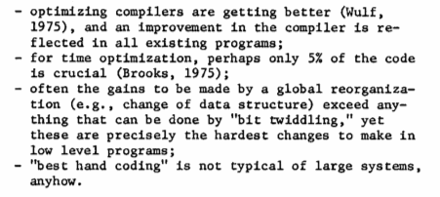
Why (1975)
James J. Horning, Yes! High level languages should be used to write systems software. ACM Annual Conference/Annual Meeting
Proceedings of the 1975 Annual Conference.
Notes:
…but is the problem still relevant today? …

Slide 26
Why Not (1972)
J.G. Fletcher et al, On the appropriate language for system programming. ACM SIGPLAN Notices, Volume 7, Number 7, 1972
Notes:
…but is the problem still relevant today? …

Slide 27
Why The 70s Shift to C?
Better language design
Better language implementation
More complex software
More complex hardware
More hardware (portability)
Charles Landau, On high-level languages for system programming
ACM SIGPLAN Notices, Volume 11, Issue 1,1976

Slide 28
Time for a Second Take?
Change continues
heterogeneous multi-core?
more complex software
Higher-level languages
type safe
memory safe
strong abstractions over hardware

Slide 29
Solutions?
Fortify low-level languages (C/C++)
Memory safety (e.g., cons. GC, talloc)
Idioms (e.g., restrictive use of types)
Tools (e.g., Valgrind’s memcheck)
Use a Systems PL
BLISS, Modula-3, Cyclone
Use two languages
FFI’s such as JNI & PInvoke
Extend a high-level language
Jikes RVM extends Java

Slide 30
Our Approach
Key Principle: Containment
Minimize exposure to low-level coding
Extensibility
Requirements change quickly
Languages change slowly
Encapsulation
Contained low-level semantics
Fine-grained lowering of semantics
Minimize impedance
Separation of concerns

Slide 31
Our Framework
Extend semantics
Intrinsic methods
Control semantics
Scoped semantic changes
Extend types
box/unbox, ref/value, arch. sizes, etc
Prefer to retain syntax (pragmatism)
Existing front-end tools useable

Slide 32
A Concrete Example
void prefetchObjects(OOP *buffer, int size) {
for(int i=0; i < size; i++) {
OOP current = buffer[i];
asm volatile("prefetchnta (%0)" ::
"r" (current));
}
}

Slide 33
A Concrete Example
void prefetchObjects(OOP *buffer, int size) {
for(int i=0; i < size; i++) {
OOP current = buffer[i];
asm volatile("prefetchnta (%0)" ::
"r" (current));
}
}

Slide 34
A Concrete Example
void prefetchObjects(OOP *buffer, int size) {
for(int i=0; i < size; i++) {
OOP current = buffer[i];
asm volatile("prefetchnta (%0)" ::
"r" (current));
}
}

Slide 35
Java Version
void prefetchObjects(
?!? buffer) {
for(int i=0;i<buffer.length;i++) {
?!? current = buffer[i];
?!?
}
}
void prefetchObjects(
OOP *buffer,
int size) {
for(int i=0;i < size;i++){
OOP o = buffer[i];
asm volatile(
"prefetchnta (%0)" ::
"r" (o));
}
}

Slide 36
“Magic” in JikesRVM
Raw access to memory?
Use int and “magic” (peek & poke)
int ref;
int value = VM_Magic.loadIntAtOffset(ref, offset);

Slide 37
“Magic” in JikesRVM
Raw access to memory?
Use int and “magic” (peek & poke)
Use ADDRESS macro (as int or long)
ADDRESS ref;
int value = VM_Magic.loadIntAtOffset(ref, offset);

Slide 38
“Magic” in JikesRVM
Raw access to memory?
Use int and “magic” (peek & poke)
Use ADDRESS macro (as int or long)
Use magical Address type (~= void*)
Typed; magic on “instance”
Address ref;
int value = ref.loadInt(offset);

Slide 39
“Magic” in JikesRVM
Raw access to memory?
Use int and “magic” (peek & poke)
Use ADDRESS macro (as int or long)
Use magical Address type (~= void*)
Use ObjectReference magic type
More strongly typed
Abstracts over mechanism (handle/pointer)

Slide 40
Java Version
void prefetchObjects(
ObjectReference[] buffer) {
for(int i=0;i<buffer.length;i++) {
ObjectReference current
= buffer[i];
?!?
}
}
void prefetchObjects(
OOP *buffer,
int size) {
for(int i=0;i < size;i++){
OOP o = buffer[i];
asm volatile(
"prefetchnta (%0)" ::
"r" (o));
}
}

Slide 41
Intrinsics
Contract between user and compiler
Implement semantics beyond language
Requires co-operation of compiler writer
Canonical intrinsics
class ObjectReference {
...
@Intrinsic{Prefetch}
void prefetch() {} // empty
...
}
Express intrinsic abstractly
e.g., Intermediate language
Intrinsics
Prefetch
LoadInt
...

Slide 42
Java Version
void prefetchObjects(
ObjectReference[] buffer) {
for(int i=0;i<buffer.length;i++) {
ObjectReference current
= buffer[i];
current.prefetch();
}
}
void prefetchObjects(
OOP *buffer,
int size) {
for(int i=0;i < size;i++){
OOP o = buffer[i];
asm volatile(
"prefetchnta (%0)" ::
"r" (o));
}
}
Other performance overheads?

Slide 43
Semantic Regimes
Scoped semantic change
Additive
UncheckedCast (allow certain intrinsics)
Subtractive
NoNew (allocation via new() not permitted)
Other
SpillAllRegisters
NoGCYield
NoBoundsChecks

Slide 44
Both Versions
@NoBoundsCheck
void prefetchObjects(
ObjectReference[] buffer) {
for(int i=0;i<buffer.length;i++) {
ObjectReference current
= buffer[i];
current.prefetch();
}
}
void prefetchObjects(
OOP *buffer,
int size) {
for(int i=0;i < size;i++){
OOP o = buffer[i];
asm volatile(
"prefetchnta (%0)" ::
"r" (o));
}
}

Slide 45
ObjectReference Abstraction
Insulates from implementation
Handles?
class ObjectReference {
int handle;
void prefetch() {
getPayload().prefetch();
}
Address getPayload() { ... }
}

Slide 46
ObjectReference Abstraction
Insulates from implementation
Handles?
class ObjectReference {
int handle;
void prefetch() {
getPayload().prefetch();
}
Address getPayload() { ... }
}

Slide 47
Summary
Higher-languages for low-level coding
Our framework
Extensible semantics (don’t bake in)
Containment of semantic change
Extend types
Much implemented
Interested in feedback, thoughts
“You mean: use sudo instead of root?”

Slide 48
Part III DaCapo Benchmarks (Just how guilty should I feel?)

Slide 50
The success of most systems innovation
hinges on benchmark performance.
Predicate 1. Benchmarks reflect current
(and ideally, future) reality.
Predicate 2. Methodology is appropriate.

Slide 51
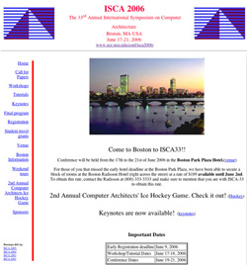
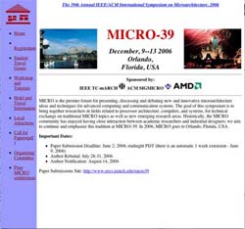
Benchmarks & Reality
JVM design & implementation
SPECjvm98 is small and jbb is relatively simple
Q: What has this done to GC research?
Q: What has this done to compiler research?
Computer architecture
ISCA & Micro rely on SPEC CPU
Q: What does this mean for Java and C# performance on modern architectures?
C#
Public benchmarks are almost non-existent
Q: How has this impacted research?

Slide 52
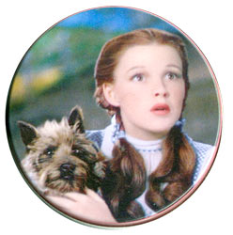
Benchmarks & Methodology
We’re not in Kansas anymore!
JIT compilation, GC, dynamic checks, etc
Methodology has not adapted
Needs to be codified and mandated
“…this sophistication provides a significant challenge to understanding complete system performance, not found in traditional languages such as C or C++”
[Hauswirth et al OOPSLA ’04]

Slide 53
Benchmarks & Methodology
1st iteration
2nd iteration
Comprehensive comparison
3 state-of-the-art JVMs
Best of 5 executions
19 benchmarks
1 platform
3rd iteration

Slide 54
Benchmarks & Methodology

Slide 55
Benchmarks & Methodology
Pentium M
AMD Athlon
SPARC

Slide 56
?
The success of most systems innovation
hinges on benchmark performance.

Predicate 1. Benchmarks reflect current
(and ideally, future) reality.

Predicate 2. Methodology is appropriate.

Slide 57
Innovation Trap
Innovation is gated by benchmarks
Poor benchmarking retards innovation & misdirects energy
Reality: inappropriate, unrealistic benchmarks
Reality: poor methodology
Examples
GC avoided in SPEC performance runs
Managed languages largely ignored by architects
C# is largely ignored by all researchers

Slide 58
How Did This Happen?
Researchers depend on SPEC
Primary purveyor & de facto guardian
Industry body concerned with product comparison
Little involvement from researchers
Not concerned with research analysis/methodology
Historically C & Fortran benchmarks
Did not update/adapt methodology for Java
But the research community depends on them!
Researchers tend not to create their own suites
Enormously expensive exercise

Slide 59
The DaCapo Suite: Goals
Open source
Encourage (& leverage) community feedback
Enable analysis of benchmark sources
Freely available, avoid intellectual property restrictions
Real, non-trivial applications
Popular, non-contrived, active applications
Use analysis to ensure non-trivial, good coverage
Responsive, not static
Adapt the suite as circumstances change
Easy to use

Slide 60
The DaCapo Suite: Today
Open source (www.dacapobench.org)
Second major release imminent
(beta2 out now!)
Real, non-trivial applications
Uncovered bugs in product JVMs
Responsive, not static
Have adapted the suite enormously
Easy to use
Single jar file, OS-independent, validation

Slide 61
Broader Impact
Just the tip of the iceberg?
Q: How many good ideas did not see light of day because of jvm98?
A problem unique to Java?
Q: How has the lack of C# benchmarks impacted research?
What’s next?
Multicore architectures, transactional memory, Fortress, dynamic languages, …
Q: Can we evaluate TM versus locking?
Q: Can we evaluate TM implementations? (SPLASH & JBB???)
Are we prepared to let major directions in our field unfold at the whim of inadequate methodology?

Slide 62
Lessons
Systems innovation is gated by benchmarks
Benchmarks & methodology can retard or accelerate innovation, focus or misdirect energy.
As a community, we have failed
We have unrealistic benchmarks and poor methodology
We have a unique opportunity
Transactional memory, multicore performance, dynamic languages, etc…
We need to take responsibility for benchmarks & methodology
Formally (eg SIGPLAN) or via ad hoc consortia (eg DaCapo)

Slide 63
Conclusions (So what did I learn in those 10 years??)

Slide 64
Conclusions
HL-LL programming is productive
Building HL-LL frameworks is hard
Evaluating modern languages is hard
It’s time for a cultural shift
In how we write systems code
In how we evaluate systems
Exciting times for language implementers
Abstraction need not be a guilty pleasure
(…and take time out to climb a mountain!)

Slide 66
Acknowledgements
Jikes RVM and Jalapeno teams
DaCapo research group
Moxie team
My co-authors, particularly:
Kathryn McKinley, Perry Cheng, Daniel Frampton, Robin Garner, David Grove, Eliot Moss, Sergey Salishev,

